Slide 1
Subprograms in Business Architecture
Chartwell Briefing
April 2005

Slide 2
Subprograms in Business Architecture
What is a subprogram in business architecture?
Why define subprograms?
How is a subprogram defined?

Slide 3
Definition of a Program
A program is a mandate and resources conferred by legislative or administrative authority to achieve outcomes within a jurisdiction and based on a strategy.
  Programs provide an essential management framework for services. They are delivered by services but are not synonymous with a collection of services.
  They provide the rationale for packaging services together into integrated solutions for clients on the demand side and the basis for developing accountability structures, business processes and resources on the supply side.

Slide 4
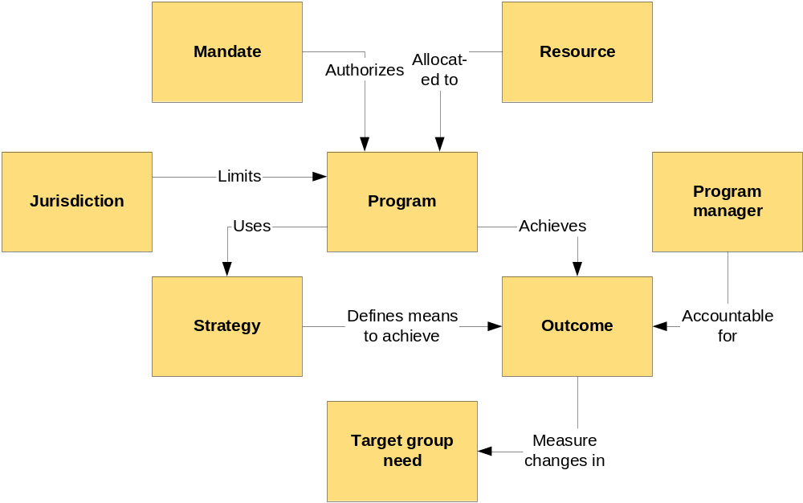
DPSH V2 recognizes subprograms implicitly but not explicitly
Pge 9: “the nutrient management program encompasses two sub-programs: environmental protection and agricultural resources programs - two different items in two different votes.”

Slide 5
GSRM recognizes subprograms explicitly
Program
Jurisdiction
Owner
Sub-
Programs
Program
Management
Processes
Outcomes
Services
Resources
Trans-
formation
Projects
Recognized
Events
Recognized
Target Group
Needs
Service
Outputs
Service
Processes
Target
Groups
Needs

Slide 6
Definition of Sub-program
A sub-program is a program that is created and administered by another program
  to delegate (vertical) accountability for some part of the parent program’s outcomes, or
  to strengthen the parent program’s capability and capacity to achieve its outcomes
Examples
  A housing program to encourage affordable housing erects two subprograms to a) finance new housing developments and b) increase municipal capacity to enforce building codes
    Rationale: separate accountability for conflicting outcomes while remaining focused on overall goal
  An enforcement program and HR program agree to erect a subprogram to attract, motivate and develop specialized resources, e.g. nuclear power engineering
    Rationale: general services provided by the enterprise’s HR Program cannot address the enforcement program’s specialized needs

Slide 7
Subprogram formal relationship to parent program (architecture and design principles)
Case 1:
  Subprogram is delegated vertical accountability for a subset of the parent program’s outcomes
Case 2
  Subprogram is authorized to assume vertical accountability to its parent for a subset of the outcomes of some program used by its parent (i.e. a provider program)
In either case:
  Is authorized to recognize a subset of the target group needs recognized by it’s parent program (case 1) or by the provider program used by its parent (case 2)
  Is assigned or allocated a subset of the Jurisdiction, Recognized Events, Services and Resources belonging to its parent (case 1) or to the provider program used by its parent (case 2)

Slide 8
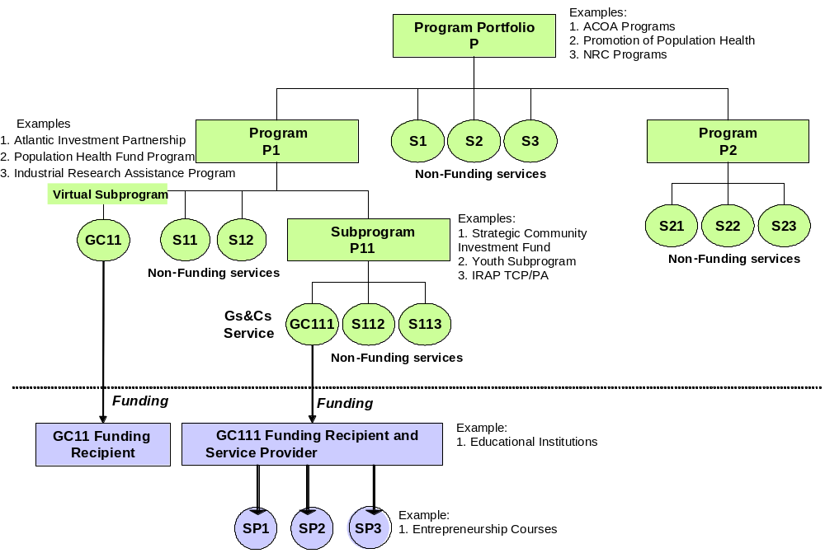
Example: Federal Grants & Contributions (Gs&Cs) Typical Program Structure

Slide 9
Why are subprograms created?
Political Reasons
  They are best practice designs - centuries of tradition and experience
  They enable political choice and control
  They isolate outcomes for maximum impact, minimum interference
Policy Reasons
  They can be focused on one policy or strategy “model”
    e.g. regulate vs. serve
    e.g. direct vs. indirect
  They separate accountabilities for conflicting outcomes and impacts
  They create more independence and flexibility re: legislation and policy
  They specialize (localize) services for different jurisdictions, target group population levels, levels of needs, “economies of locality”
  They isolate services with different life spans or stages of maturity or rates of change
  They create or deploy unique/specialized resources
Organizational Reasons
  They can be aligned with vertical accountability, i.e. organization structure and boundaries
  They reduce span of control
  They align with funding structures
Provider Programs Only
  They control and steward a limited or common resource
  They offer common services to providers leading to “economies of scale”
  They buffer/adapt other provider programs (interfaces) to localize their outputs

Slide 10
Example:
ICT PLM forms strategic program boundary
Maximum
Information Asset
Leverage
Joined-up
Services
Desired
Program
Impacts
Business
Interoperability
Achieved
Technical
Interoperability
Achieved
Information
Interoperability
Achieved
Intended
Program
Outcomes
Technical
Interoperability
Means Available
Information
Interoperability
Means Available
Business
Interoperability
Means Available
Program
Outputs
Secure
Channel Sessions
Data
Transformations
Standard
Process
Models
ebML
Directories
Standard
Vocabularies
Target
Group
Needs
Safe Data
Transport
Data
Standardization
Business
Process
Standardization
Business
Collaboration
Mechanism

Slide 11
ICT subprogram structure differentiates tactical outcomes
Maximum
Information Asset
Leverage
Joined-up
Services
Desired
Program
Impacts
Business
Interoperability
Achieved
Technical
Interoperability
Achieved
Information
Interoperability
Achieved
Intended
Program
Outcomes
Technical
Interoperability
Means Available
Information
Interoperability
Means Available
Business
Interoperability
Means Available
COMMON
INFRASTRUCTURE
SUBPROGRAM
BUSINESS
INTEROPERABILITY
SUBPROGRAM
Program
Outputs
Secure
Channel Sessions
Data
Transformations
Standard
Process
Models
ebML
Directories
Standard
Vocabularies
Target
Group
Needs
Safe Data
Transport
Data
Standardization
Business
Process
Standardization
Business
Collaboration
Mechanism

Slide 12
Example: HR program PLM
Workforce
Has Capacity
Workforce
Is Capable
Workforce
Is Mobile
Desired
Program
Impacts
Workforce
Is Multi-Skilled
Workforce
Supply Is
Adequate
Workforce
Is Motivated
Intended
Program
Outcomes
Relevant
Training Is
Available
Succession
Plans Are
Available
Recruits Are
Available
Motivational
Outputs Are
Available
Compensation
Is Competitive
Succession
Planning
Communications
Program
Outputs
Training
Courses
Awards
Job
Enrichment
Education
Grants
Recruiting
Compensation
Target
Group
Needs
TBD

Slide 13
HR subprogram structure
Workforce
Has Capacity
Workforce
Is Capable
Workforce
Is Mobile
Desired
Program
Impacts
Workforce
Is Multi-Skilled
Workforce
Supply Is
Adequate
Workforce
Is Motivated
Intended
Program
Outcomes
Relevant
Training Is
Available
Succession
Plans Are
Available
Recruits Are
Available
Motivational
Outputs Are
Available
Compensation
Is Competitive
Succession
Planning
Communications
Program
Outputs
Training
Courses
Awards
Job
Enrichment
Education
Grants
Recruiting
Compensation
Capability
Subprogram
Supply
Subprogram
Target
Group
Needs
Motivation
Subprogram

Slide 14
Program Structure vs. Organization Structure
Impact
Essentially
Complex
Mapping
Impact
Impact
Impact
Outcome
Outcome
Outcome
Outcome
Outcome
Outcome
Program
Organization
Unit
Simple
Mapping
Accidentally
Complex
Mapping
Organization
Subunit
Organization
Subunit
Subprogram
Subprogram
Organization
Sub-subunit
Organization
Sub-subunit
Organization
Sub-subunit
Sub-
subprogram
Sub-
subprogram
Sub-
subprogram

Slide 15
Consequences of each additional subprogram
Coordination and interoperability requirements with other programs increases
More management processes, e.g. resource allocation
More potential for service duplication, esp. provider services
More variations in service and service standards
More management complexity

Slide 16
UML Representation
Program
Composite
Program
Sub
Program
(Leaf)

Slide 17
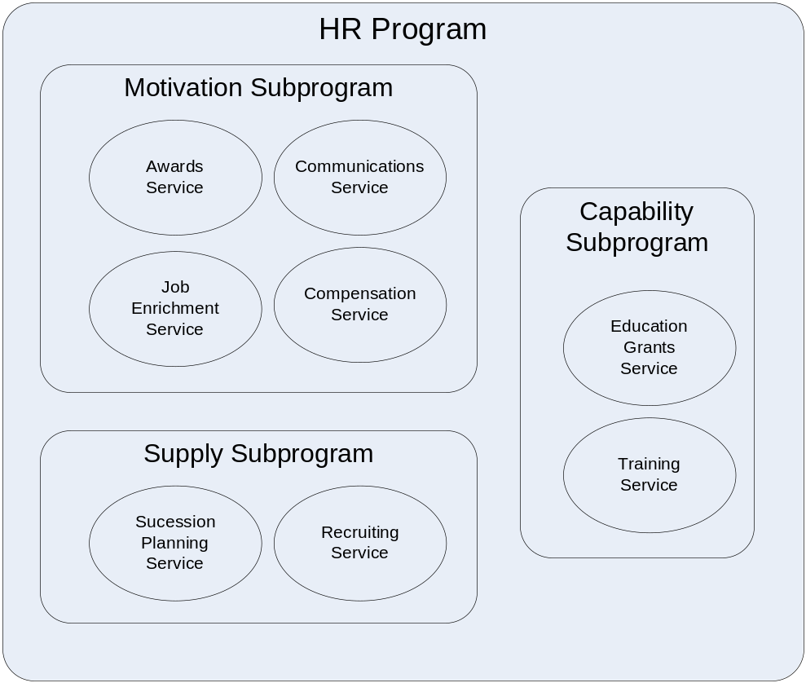
Notation

